Slide 1

Startup Funding India
This Presentation is consist of detailed key insight which I found about the funding which Indian start-up got in recent years. This presentation is consist of exploratory data analysis and trying to find some insight and present it in good visualization so it can be helpful for decision making.
Notes:
Photo by Chris Barbalis on Unsplash

Slide 2
Introduction
The data consist of total 3044 startup which are started in India from year 2015 to 2020.
The startup are consist of various verticals and different locations in which these startup are located and who are the investors who invest in this startup.
I use ms-excel, python for data cleansing and matplotlib and tableau for data visualization.
Notes:
Photo by Campaign Creators on Unsplashcampaign-creators-pypeCEaJeZY-unsplash.jpg

Slide 3
Year wise Total count of startup which got funding.
Total Number of start-up which got funding in different years.
.
Maximum start-up got funding in year 2016.But the problem is that with upcoming years the funding for number of start-up is decreasing. The year 2019-2020 have make a huge impact on business and that is may be a reason why investors are reluctant to invest in more new startups.
Notes:
Photo by Campaign Creators on Unsplashcampaign-creators-pypeCEaJeZY-unsplash.jpg

Slide 4
Which Startup got maximum funding and how much much amount they got ?
Rapido Bike taxi got maximum funding of 3900000000 USD. The industry sector in which it is working is Transport and city is Bengaluru.
Hostel Dunia,Play your sport,yo grad got minimum funding of 16000 USD.The industry sector are not mentioned.
Which Start-up got minimum funding and how much amount they got?
Notes:
Photo by Campaign Creators on Unsplashcampaign-creators-pypeCEaJeZY-unsplash.jpg

Slide 5
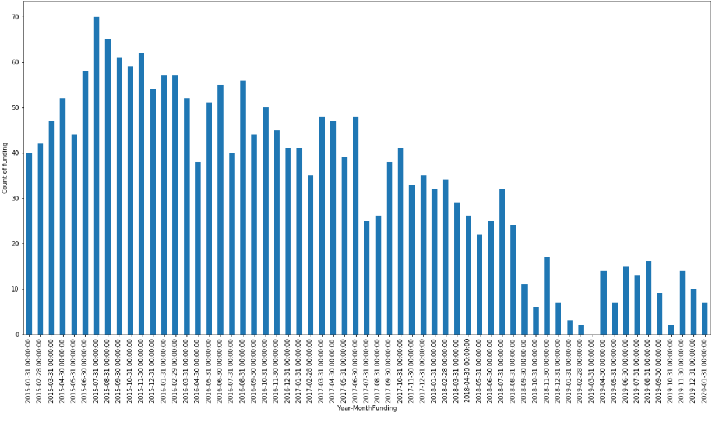
Year wise Total count of startup which got funding.
Total Number of start-up which got funding in different months-year wise.
.
The highest number of start-up which got funding is in month of July of year 2015.The average number of start-up are around 40 every month which got funding.
Notes:
Photo by Campaign Creators on Unsplashcampaign-creators-pypeCEaJeZY-unsplash.jpg

Slide 6
Total 20 Start-up which got Maximum Number of funding.
.
Clearly it is found that Ola cabs,swiggy got maximum number of funding in this years followed by paytm.
Notes:
Photo by Campaign Creators on Unsplashcampaign-creators-pypeCEaJeZY-unsplash.jpg

Slide 7
Total 20 Start-up which got Maximum Number of funding.
.
Clearly it is found that Ola cabs,swiggy got maximum number of funding in this years followed by paytm.
Notes:
Photo by Campaign Creators on Unsplashcampaign-creators-pypeCEaJeZY-unsplash.jpg

Slide 8
Which type of Start-ups getting more funding's.
.
Consumer Internet industry companies type of company got maximum funding followed by technology, ecommerce
Notes:
Photo by Campaign Creators on Unsplashcampaign-creators-pypeCEaJeZY-unsplash.jpg

Slide 9
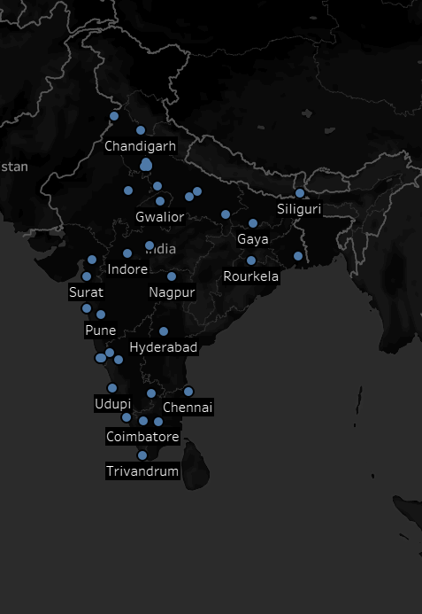
How Start-ups are distributed in different cities of India.
.
Clearly Bangalore has maximum number of start-up around 841 followed by Mumbai 567.
Notes:
Photo by Campaign Creators on Unsplashcampaign-creators-pypeCEaJeZY-unsplash.jpg

Slide 10
THANK
YOU

